Slide 1
Finite Element Analysis of a Compact Clamped-Clamped NEM Relay
Analysis Updates
Akash Levy
7/17/20

Slide 2
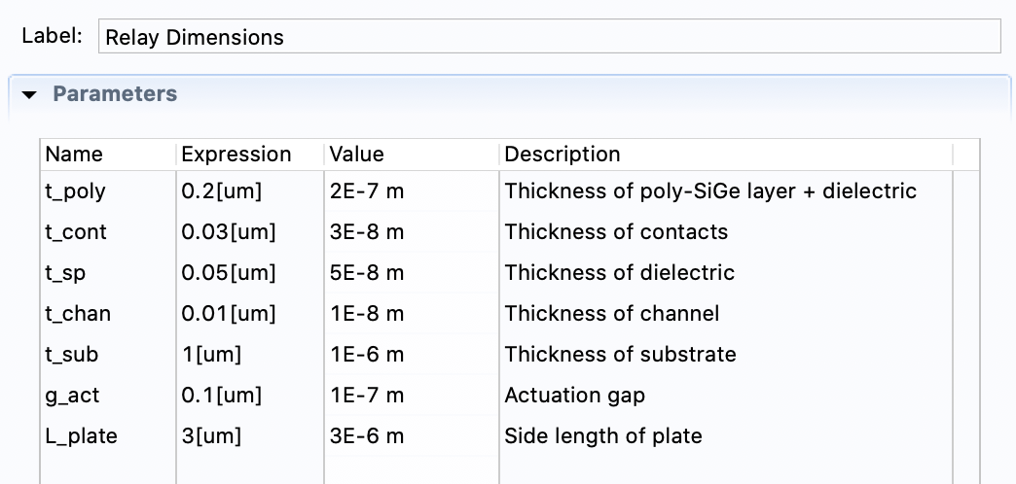
Relay Thickness Dimensions: Parametrized

Slide 3
Relay Components
Relay + Substrate
Spherical Universe
Substrate Components

Slide 4
Meshing
Simple mesh vs. full mesh
Simple mesh uses swept surface mesh on substrate and poly-Si layers and free tetrahedral elements everywhere else
Full mesh uses free tetrahedral elements everywhere
Full mesh used for quick analyses
Simple mesh used for harder analyses

Slide 5
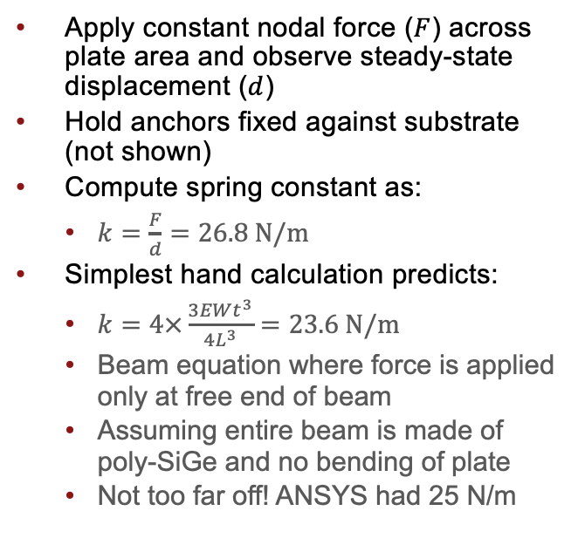
Spring Constant Determination
Apply constant nodal force ($F$) across plate area and observe steady-state displacement ($d$)
Hold anchors fixed against substrate (not shown)
Compute spring constant as:
$k=\frac{F}{d}=26.8 N/m$
Simplest hand calculation predicts:
$k=4×\frac{3EWt^{3}}{{4L}^{3}}=23.6 N/m$
Beam equation where force is applied only at free end of beam
Assuming entire beam is made of poly-SiGe and no bending of plate
Not too far off! ANSYS had 25 N/m
Boundary Loads

Slide 6
Stress and Strain
Elastic stress and strain can help us understand stressed locations
Can show points of possible relay fracture
Hot spots appear at corners
Generally look where differential bending is high
For a 1e-8 N force:
Maximum stress:
Maximum strain:

Slide 7
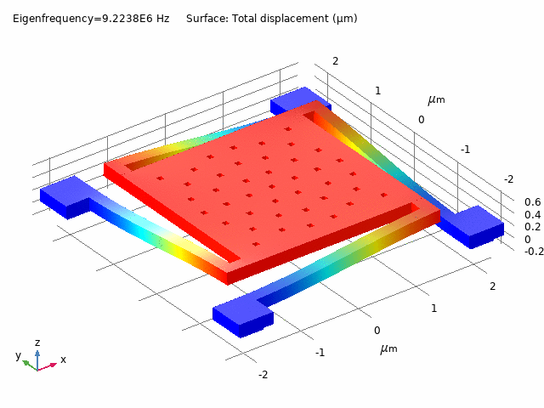
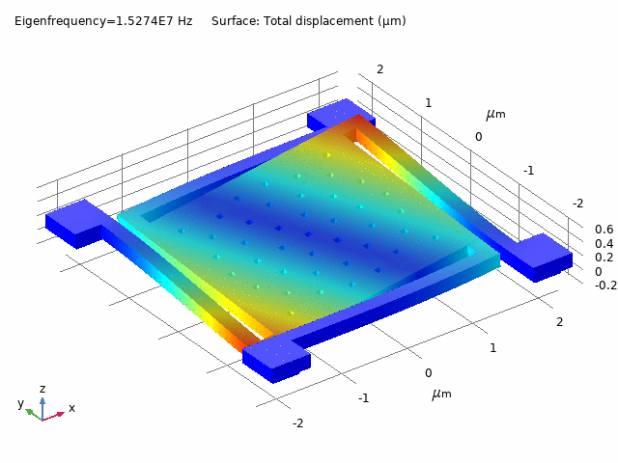
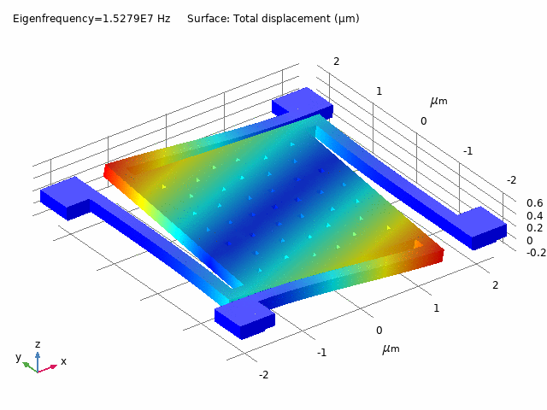
Modal Analysis
Shows dominant modes of relay motion (rotational, flexural, etc.)
Way to understand relay motion and time constants
Can also extract spring constant from the first mode

Slide 8
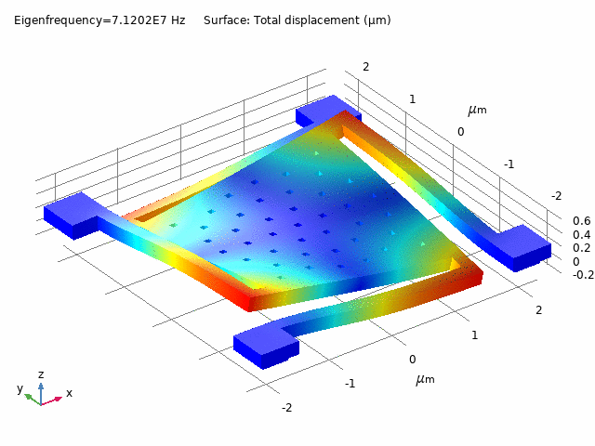
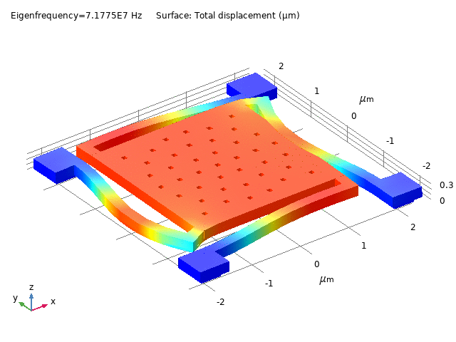
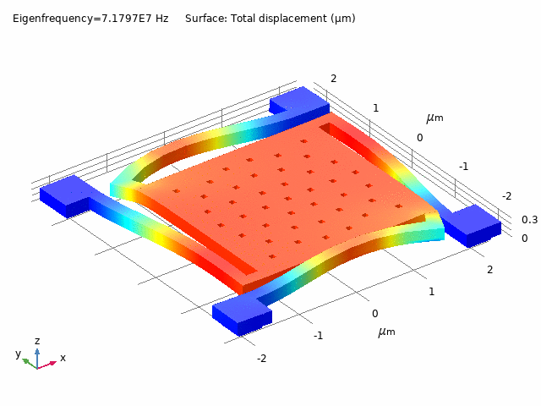
Modal Analysis
Shows dominant modes of relay motion (rotational, flexural, etc.)
Way to understand relay motion and time constants
Can also extract spring constant from the first mode

Slide 9
Quasi-Static Analysis
Time-dependent analysis
Inertial terms ignored
Damping included to prevent instability of solution
Slowly sweep gate voltage (with relay grounded)
Observe steady-state displacement
Green curve: castor oil
Blue curve: vacuum/air

Slide 10
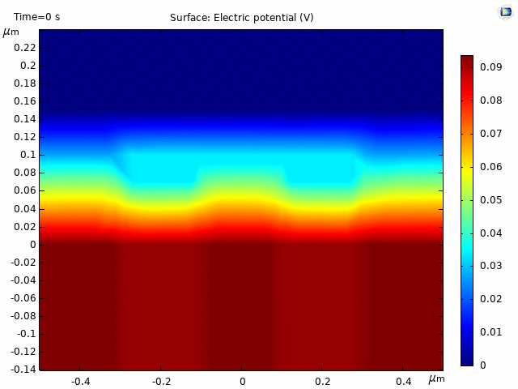
Quasi-Static Analysis
Time-dependent analysis
Inertial terms ignored
Damping included to prevent instability of solution
Slowly sweep gate voltage (with relay grounded)
Observe steady-state displacement
Green curve: castor oil
Blue curve: vacuum/air

Slide 11
Contact Force and Resistance Modeling
Contact cannot be directly modeled with built-in tool when an ambient is present (in both COMSOL and ANSYS
Ambient is required in COMSOL for electric fields to be modeled
Using penalty-based contact force (spring-based method)
Smoothed using exponential decay for convergence
Conserves system energy
Does this approach look valid?

Slide 12
Contact Force and Resistance Modeling (previous)

Slide 13
Contact Force and Resistance Modeling (previous)
Stdev Contact Force: 700nN, Stdev Intrinsic Contact Resistance: 1.4 Ω

Slide 14
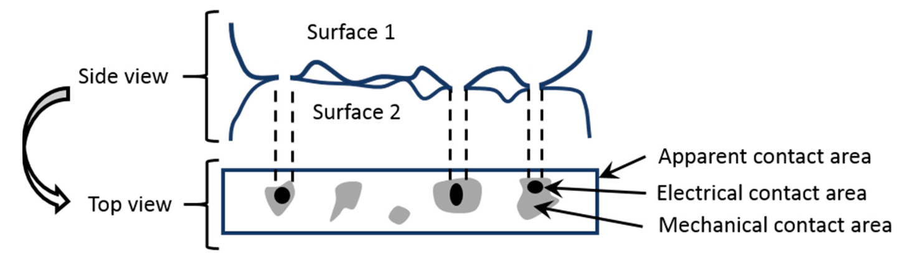
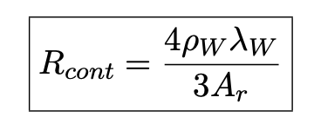
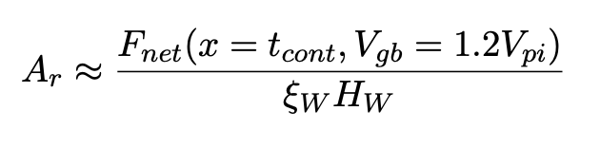
Contact Force and Resistance Modeling
Conclusion is that we need to optimize contact placement
We need multi-pole contact placement for uniform contact resistance
Strategy would be strong addition to a paper
UPDATE: Using rotational symmetry and extract rotation offset from displacement contour
Asperity-Based Contact Resistance Model

Slide 15
Contact Force and Resistance Modeling (now)

Slide 16
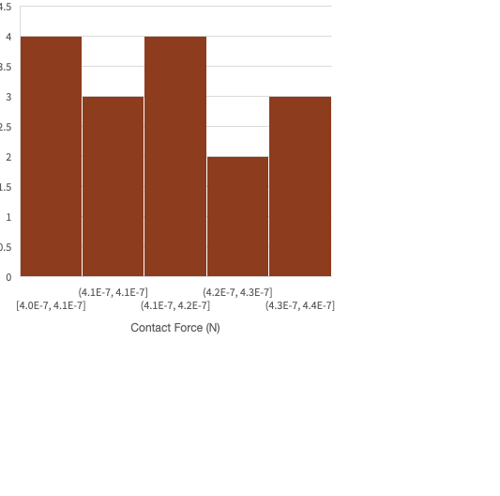
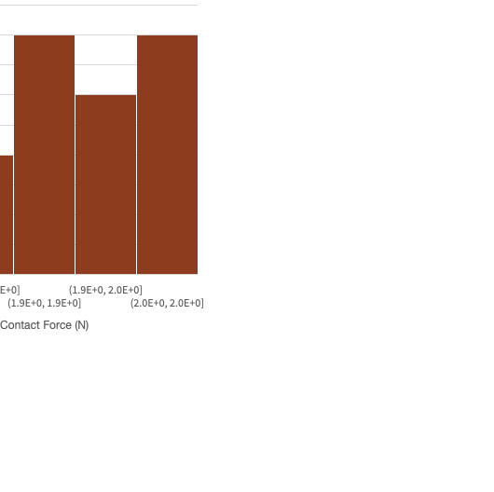
Contact Force and Resistance Modeling (now)
Stdev Contact Force: 15nN, Stdev Intrinsic Contact Resistance: 0.067 Ω

Slide 17
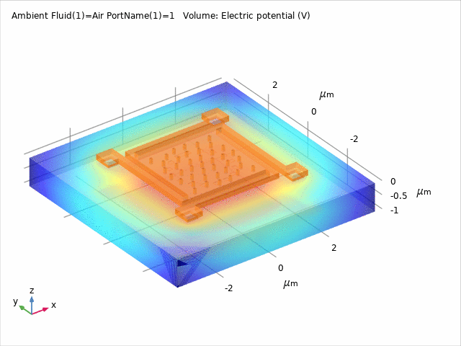
Parasitic Extraction: Technique
Using stationary source sweep
Sets each of the 26 relay terminals to 1V and rest to ground
Relay terminal list:
Gate on Substrate (x1)
Relay Body (x1)
Contact & Channel (x8)
Landing Pads on Substrate (x16)
Models electric field inside spherical universe from earlier
Extracts mutual capacitance using matrix transformation on Maxwell capacitance

Slide 18
PEX Results (OFF)
For reference: 40nm minsize inverter capacitance is ~1e-16 F
Air/Vacuum | Gate | Body | Landing Pad | Channel
Gate | 1.4e-16 F | 1.2e-15 F | 5.7e-16 F | 8.3e-18 F
Body | 1.2e-15 F | 3.2e-16 F | 7.0e-19 F | 1.2e-16 F
Landing Pad | 5.7e-16 F | 7.0e-19 F | 1.3e-19 F | ~0 F
Channel | 8.3e-18 F | 1.2e-16 F | ~0 F | ~0 F
Castor Oil | Gate | Body | Landing Pad | Channel
Gate | 4.2e-16 F | 3.2e-15 F | 5.7e-15 F | 4.3e-17 F
Body | 3.2e-15 F | 1.1e-15 F | 2.3e-18 F | 1.4e-16
Landing Pad | 5.7e-16 F | 2.3e-18 F | 7.4e-19 F | ~0 F
Channel | 4.3e-17 F | 1.4e-16 | ~0 F | ~0 F
All within a factor of 2 of parallel plate capacitor treatment!

Slide 19
Modal Analysis with Viscous Damping
Material | Viscosity (Pa s) | Mode # | Damping ratio | Q factor
Air | 1.8e-5 | 1 | 5.9e-9 | 8.5e7
Air | 1.8e-5 | 2 | 1.0e-8 | 4.8e7
Castor Oil | 0.957 | 1 | 3.3e-4 | 1511
Castor Oil | 0.957 | 2 | 5.6e-4 | 893
We previously said these seemed unrealistic
Probably better to compute using a proper FEA simulation

Slide 20
Transient Sweeps
25ns pull-in time without damping, 50ns with bounce
With damping in air: ~26ns
Viscous fluid damping
Unable to solve with castor oil for some reason
Will structural damping/dissipation play an important role in preventing contact bounce?
Displaying viscous laminar flow in air

Slide 21
Other Configurations
2D modeling for damping coefficient extraction
Can assume ~0 pressure around perforations and assume thin-film flow (using Reynold’s equation)
Can also go and look at molecular flow regime
COMSOL has tools for both
On the right: perforated MEMS with computations damping coefficient computed

Slide 22
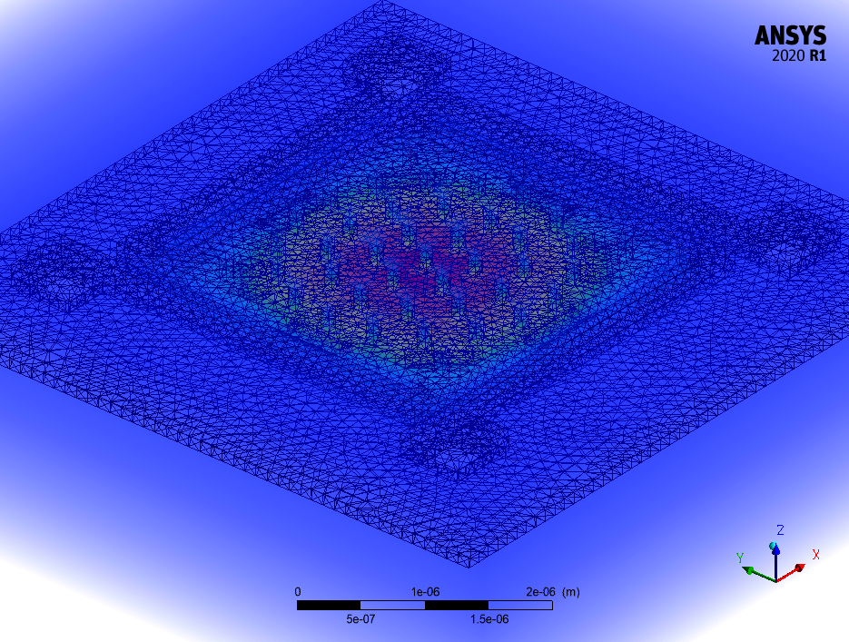
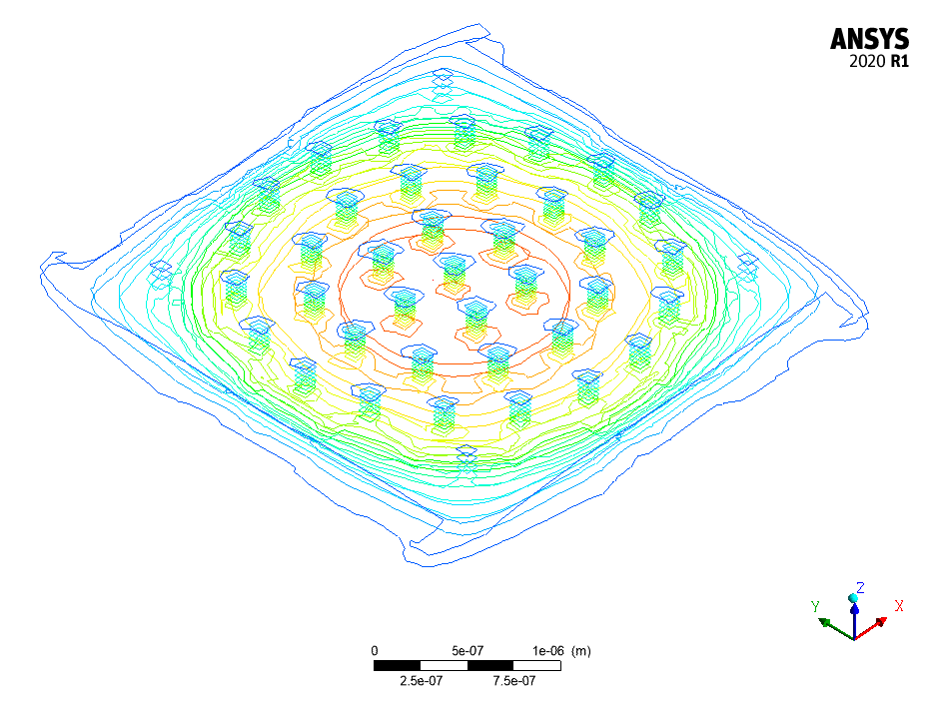
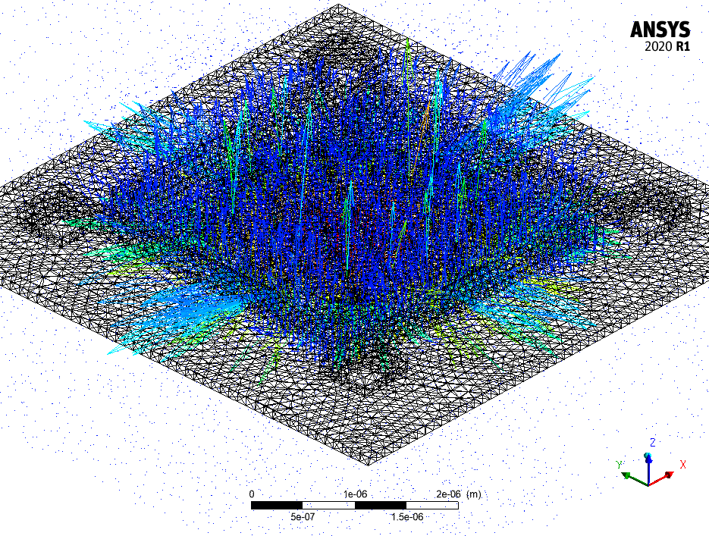
ANSYS Plots From CFD
Pressure
Pressure Contour
Velocity

Slide 23
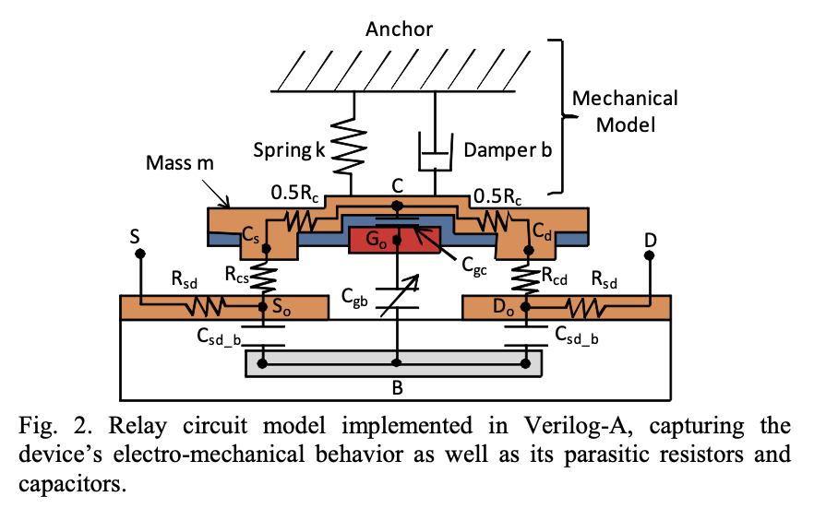
Goal for SPICE Model
Ultimately, we want to work with reduced-order models suitable for SPICE simulation
Goal: extract key parameters that capture essence of FEA model
Possible simplified model of relay is shown below (from Berkeley)

Slide 24
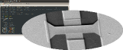
Updates on SPICE Model
Adapted a model found online
Verilog-A Large-Signal RF MEMS Model Library
http://rfmems.sourceforge.net/
Removed a lot of unnecessary features
(Brownian motion, RF-specific stuff)
High schooler (Akhilesh) created generators for multi-pole variant
Also developed and currently testing NEM multiplexer SPICE models
TODO: compare transient simulations across models

Slide 25
Coming Up
Finalizing the fluidic stuff
Parasitic extraction in the ON state for validation
Transient simulation and comparison to SPICE model
Parameter sweeps (if time permits and it seems useful)

Slide 26
Thank you!
Questions?

